Slide 1
Efficient Transformers:
Reformer, Performer and Informer

Slide 2
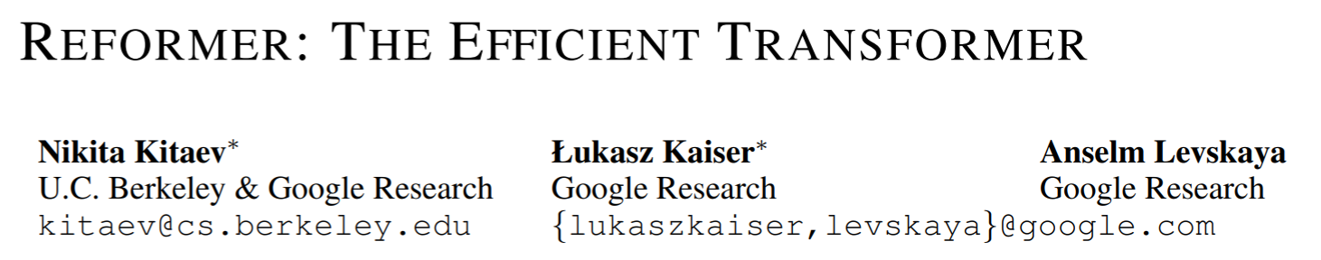
ICLR 2020

Slide 3
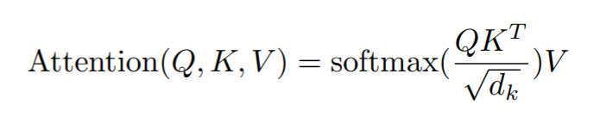
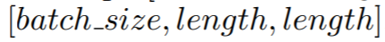
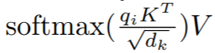
Motivation
If length=64K, it takes 16GB memory.
A naïve solution: but less efficient
Shared-QK transformer:
We use the same linear layer to go from A to Q and K, and a separate one for V.
It turns out that sharing QK does not affect the performance of Transformer.
So Q=K.
Since softmax is dominated by the largest elements, for each query qi we only need to focus on the keys in K that are closest to qi.

Slide 4
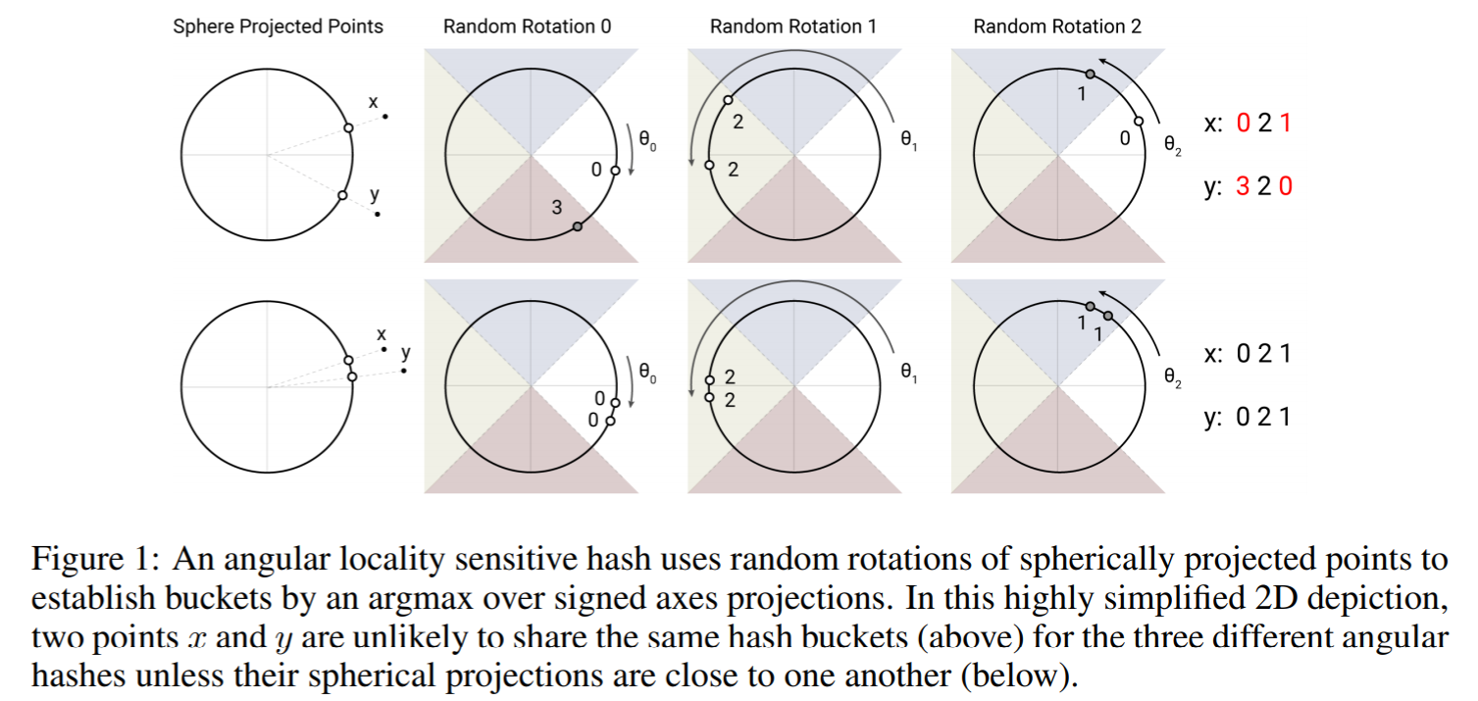
Locality-Sensitive Hashing Attention
The problem of finding nearest neighbors quickly in high-dimensional spaces can be solved by locality-sensitive hashing (LSH).
A hashing scheme that assigns each vector x to a hash h(x) is called locality-sensitive if nearby vectors get the same hash with high probability and distant ones do not.

Slide 5

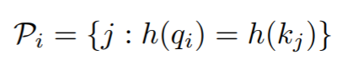
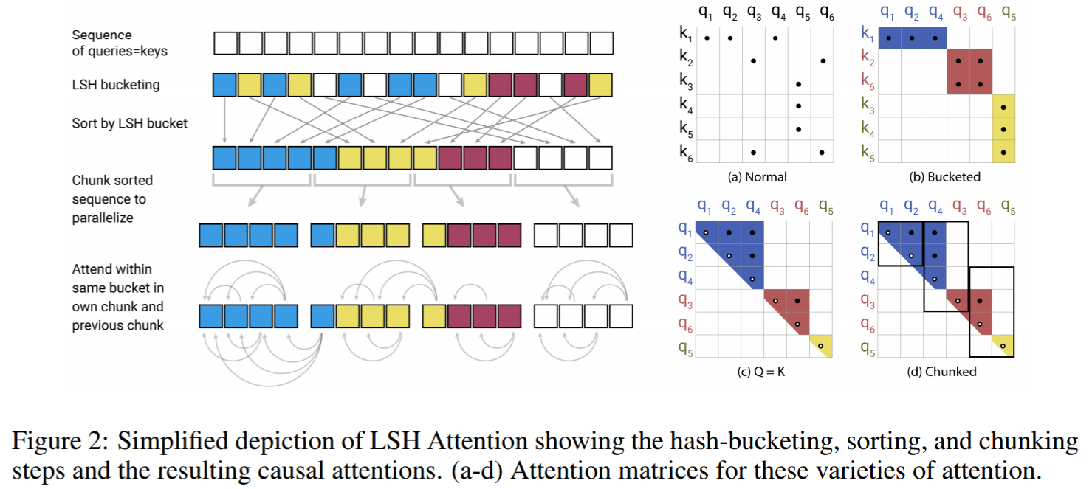
Locality-Sensitive Hashing Attention
LSH Attention:

Slide 6
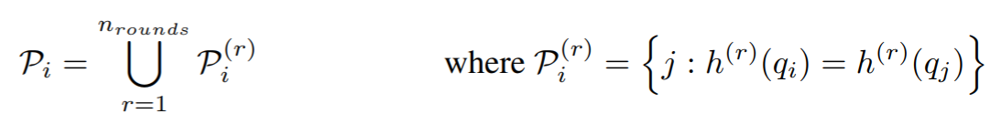
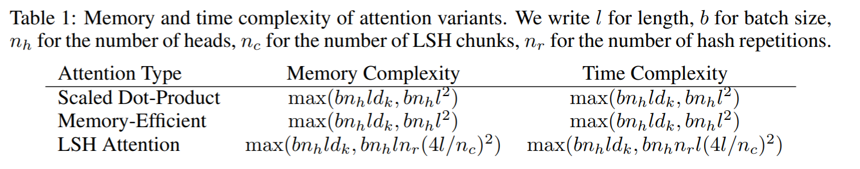
Locality-Sensitive Hashing Attention
Multi-round LSH attention:

Slide 7
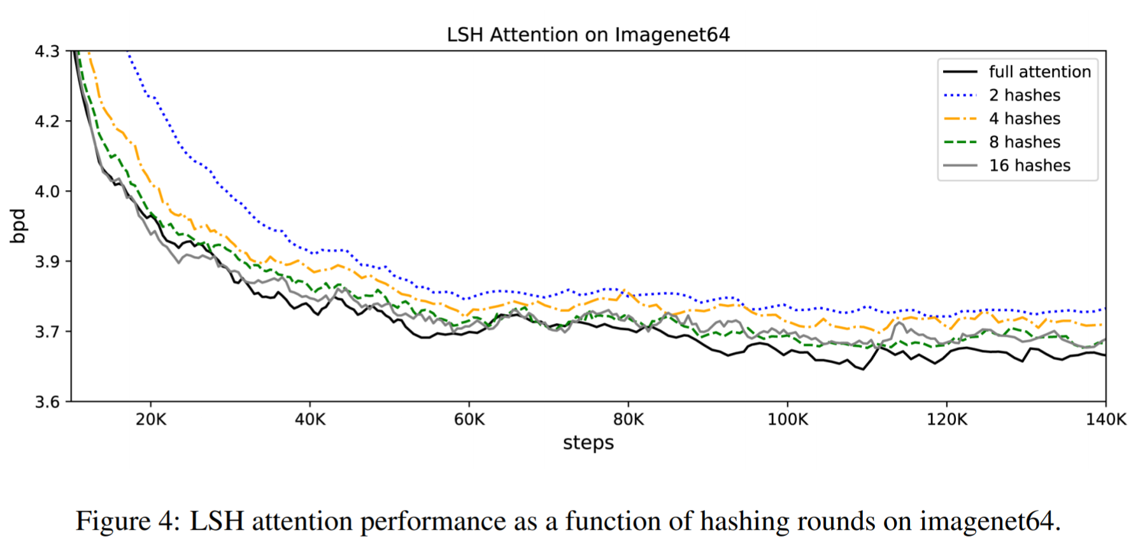
Experiments

Slide 8
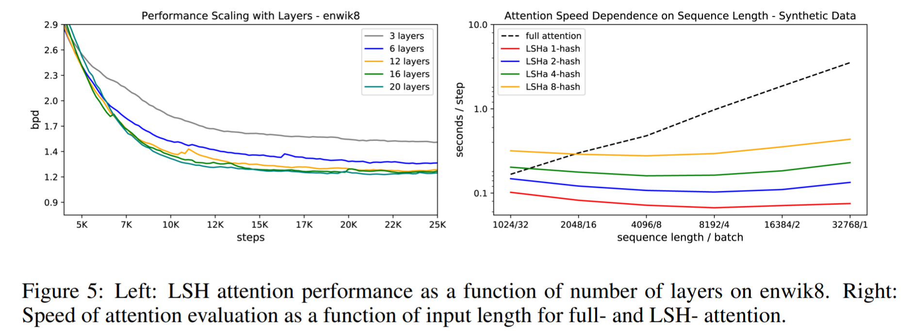
Experiments

Slide 9
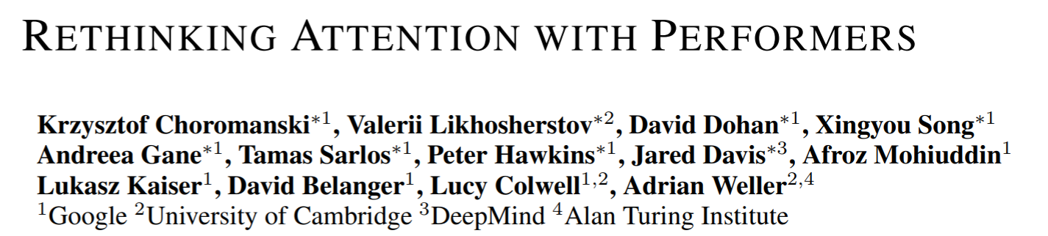
ICLR 2021

Slide 10

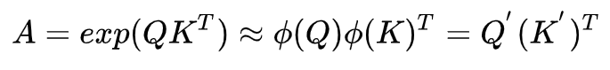
FAVOR+
Fast Attention Via Orthogonal Random Features
Regular attention:
We will show that attention matrix A can be approximated up to any precision.
Is that possible?

Slide 11
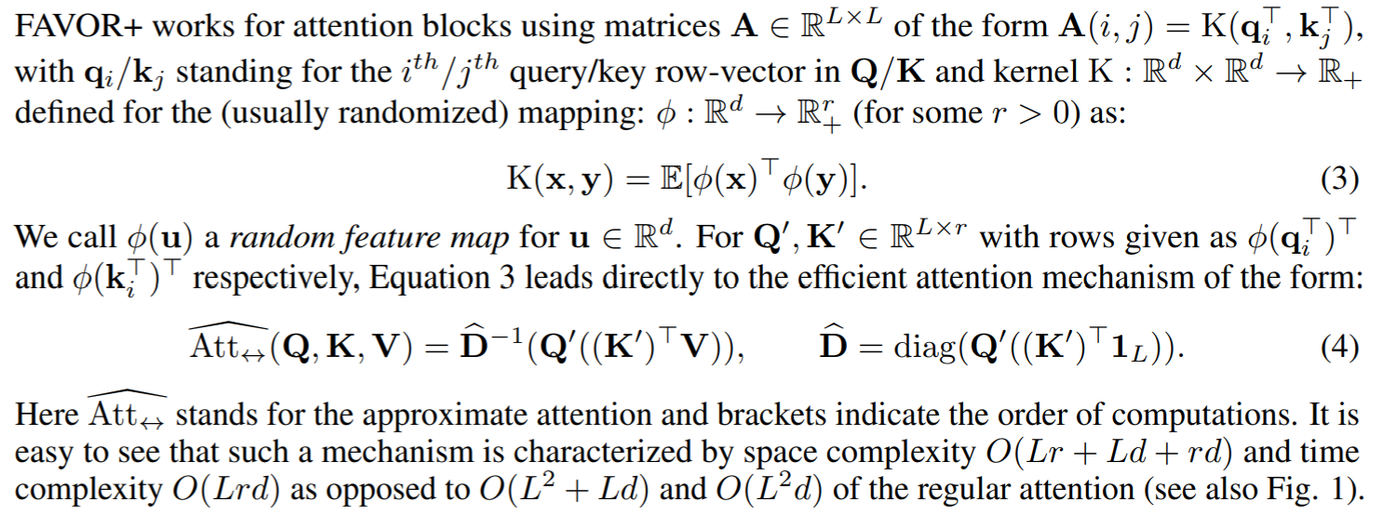
FAVOR+
Kernel function

Slide 12
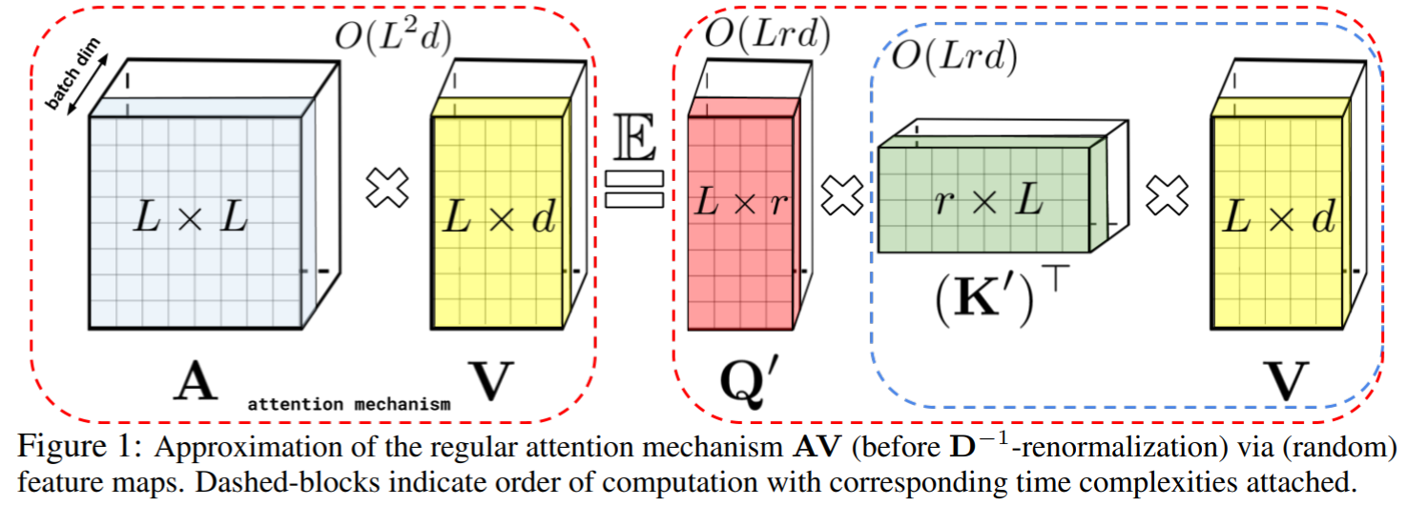
FAVOR+
The FA-part of the FAVOR+ mechanism

Slide 13
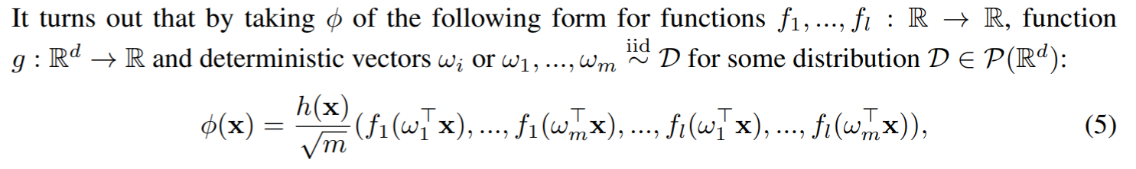
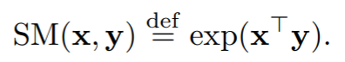


FAVOR+
Approximate softmax-kernels for attention
sin and cos might be negative and unstable.

Slide 14
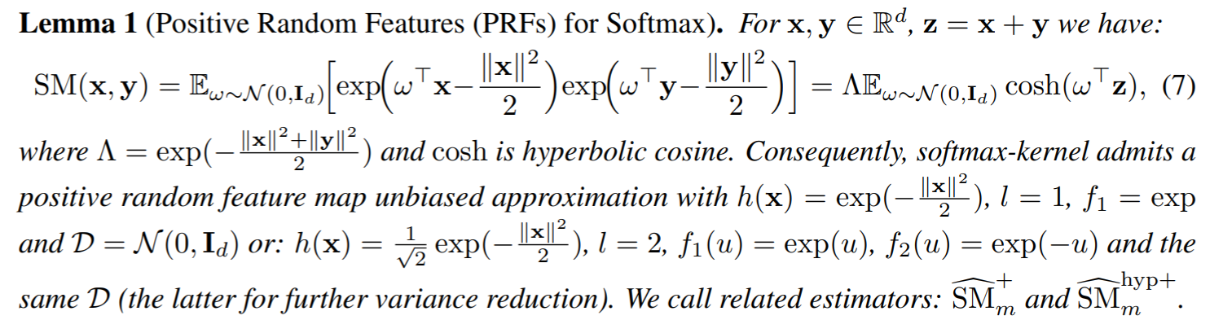
FAVOR+
Approximate softmax-kernels for attention
The R-part of the FAVOR+ mechanism

Slide 15
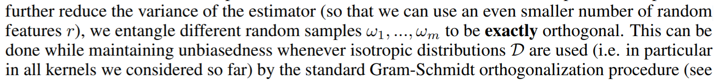
FAVOR+
The O-part of the FAVOR+ mechanism

Slide 16
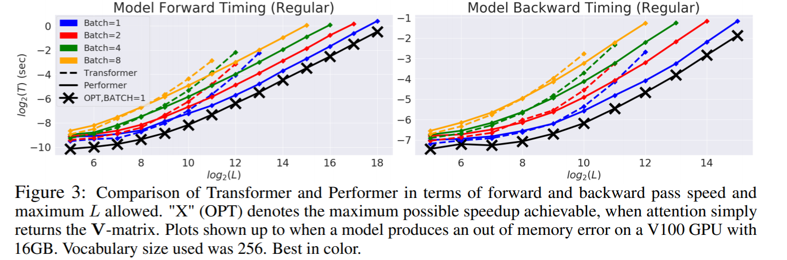
Experiments

Slide 17
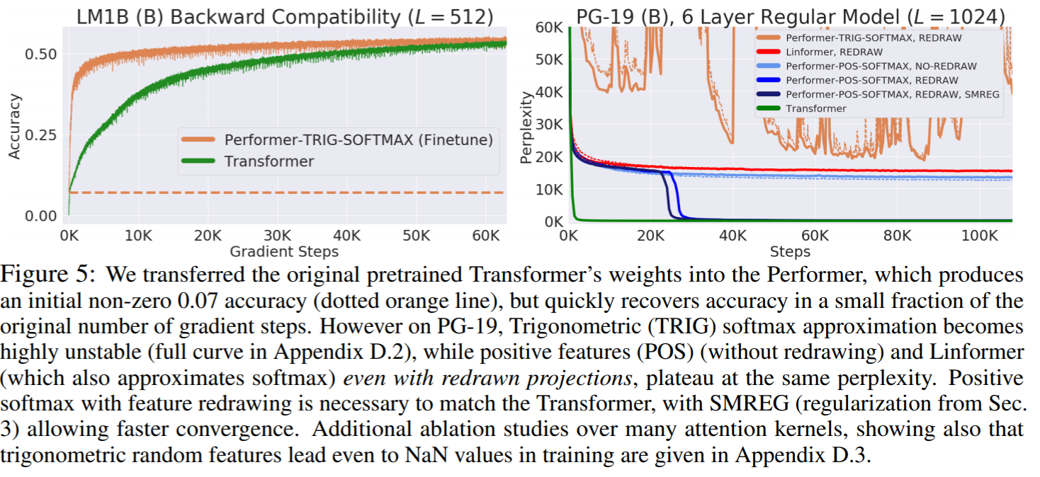
Experiments

Slide 18
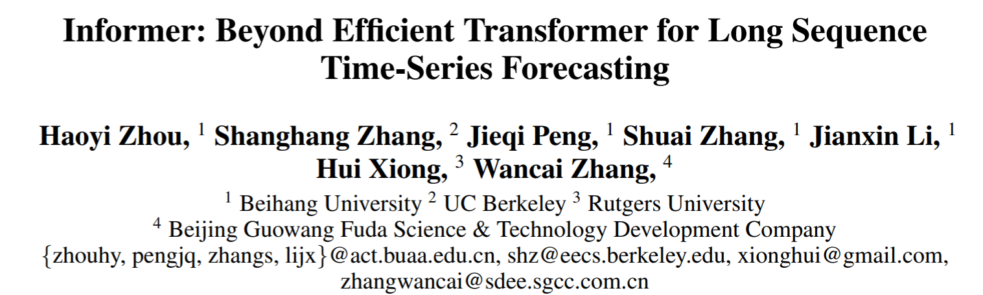
AAAI 2021

Slide 19
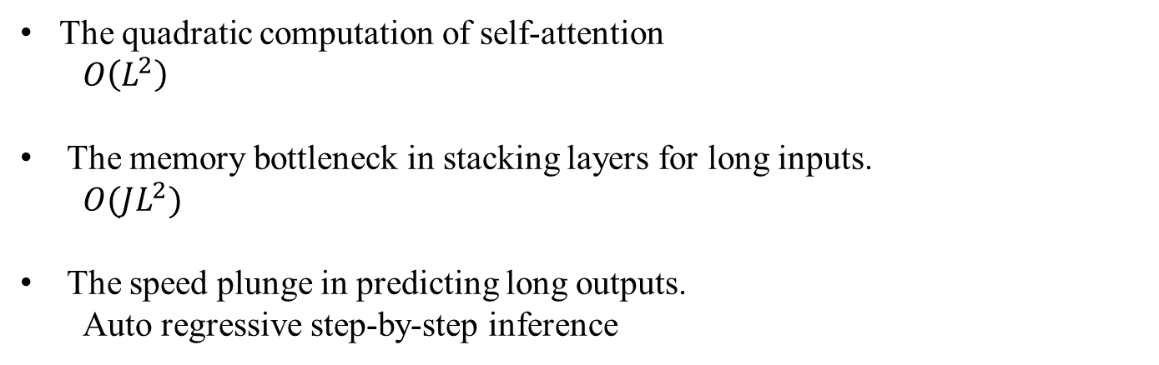
Motivations
The quadratic computation of self-attention
$$O\left(L^{2}\right)$$
The memory bottleneck in stacking layers for long inputs.
$$O(JL^{2})$$
The speed plunge in predicting long outputs.
Auto regressive step-by-step inference

Slide 20
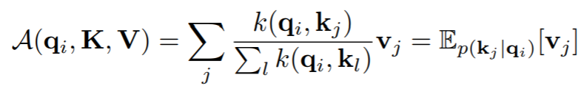
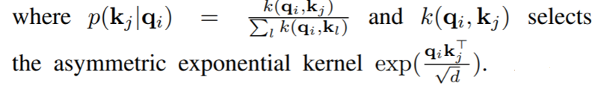
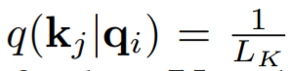
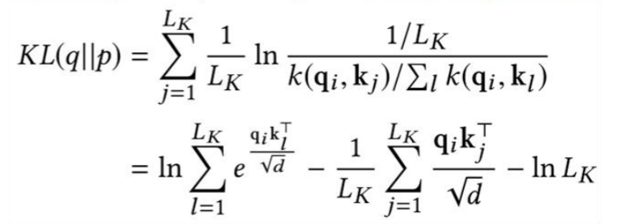
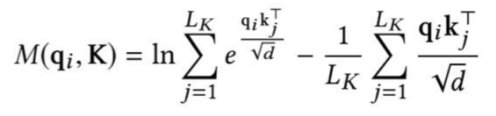
Methods
Uniform distribution
The “likeness” between distribution p and q can be used to distinguish the “important” queries.
Define the i-th query’s sparsity measurement

Slide 21
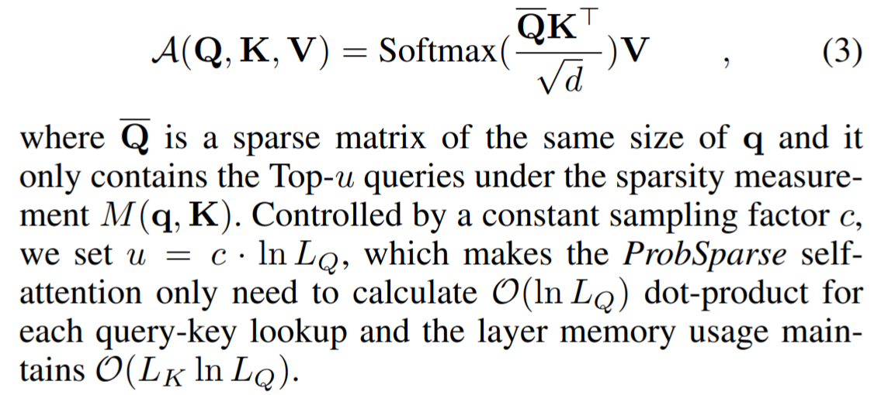
Methods -- ProbSparse Self-attention

Slide 22
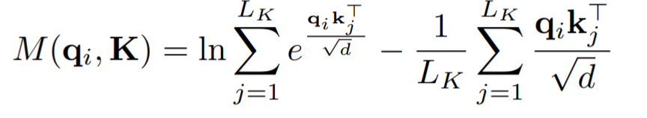
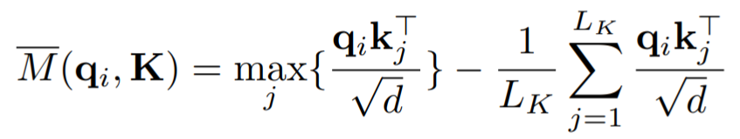
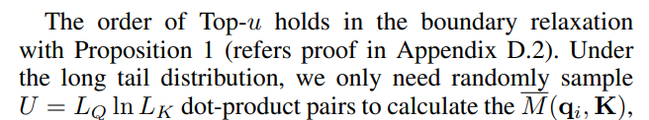
Methods -- ProbSparse Self-attention
an approximation to the query sparsity measurement.

Slide 23
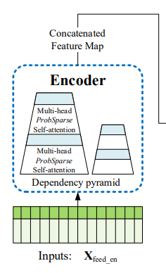
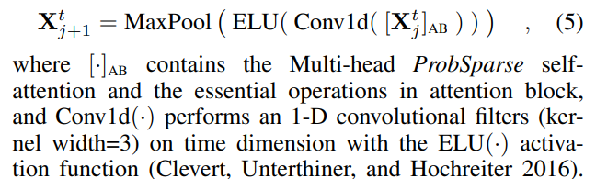
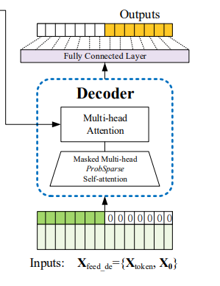
Methods – Encoder-Decoder
Self-attention Distilling
Generative Style Decoder

Slide 24
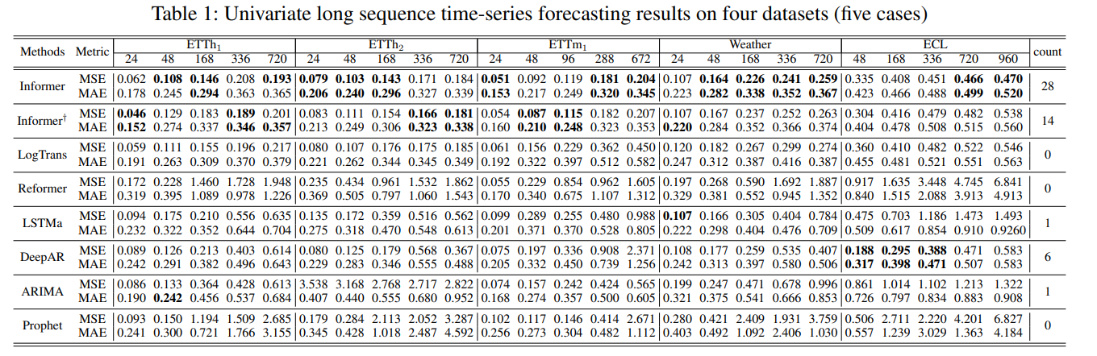
Experiments

Slide 25
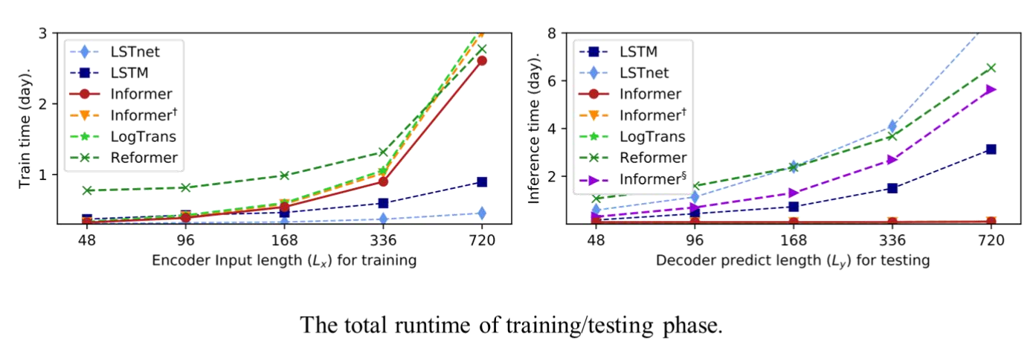
Experiments

